Slide 1
Capstone Project
Where to open new Yoga-related Tea Stores in New York?

Slide 2
The business problem
A business (stakeholder/target audience) want to open 5 tea stores in New York city selling also Yoga, meditation and alternative medicine equipment/books/tools/etc.
They want to find out how Yoga-related venues are distributed in the area, and how efficiently these could be clustered to be served by each of the 5 stores in proximity, optimally within walking distance and with minimum number of river and bridge crossings (to make it easier for cyclists and walkers).

Slide 3
The data
We compiled a list of all yoga-related venues and their location data within a specific radius of New York City using Foursquare's database via their API:
'explore' endpoint via a Regular API call
containing the query "Yoga Studio", being the predominant Foursquare database category for yoga-related venues.
The main data are Venue Name, Latitude and Longitude.
Extract, pre-process and load the data into a framework (dataframe) ready for modeling and evaluation.

Slide 4
The methodology
Data Understanding & Preparation
Foursquare DB -> JSON -> Dataframe
Exploratory data analysis
Visualize yoga-related venues within a radius of 5km of New York City geographical centre superimposed on top of the city map -> geographical spread of the venues -> insights on possible challenges in covering distant and across-the-river venues.
Modeling
k-means algorithm used - simple but powerful for quickly discovering insights from unlabeled data.
Initial feature set: distance of each venue from specific New York neighborhoods -> inef inefficient, difficult to establish optimally centered neighborhoods.
Final feature set: geographical coordinates (latitude, longitude) -> optimal clusters based on the similarity of venues' geocoordinates.
k-means algorithm was setup to run 10 times with different centroids, with the best outcome as final result.

Slide 5
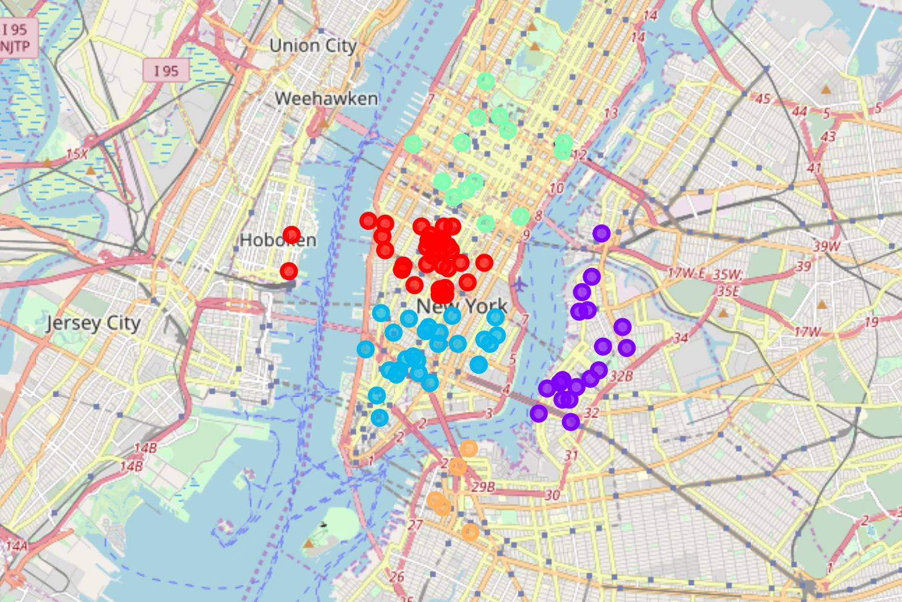
Results
The k-means algorithm grouped 100 venues in 5 clusters. 4 out of 5 clusters contain significant number of venues in proximity to their optimal centroid, in order to justify opening a yoga-related tea store at or near the cluster's centroid. Only one cluster contains a couple of across-the-river venues, however the number is a very small percentage of the total number of venues the cluster contains.

Slide 6
Discussion & conclusion
An interesting observation is that the k-means algorithm was succesful in "taking into account" the presence of the river, producing 4 clusters that are not separated by any body of water.
This exercise aimed to address in a highly qualified way a simple question using similarly simple but powerful techniques.

